Slide 1
PISA 2018 Data Analysis
Greece's Educational Performance & Gender Gaps
Static Visualizations
Data Source: OECD PISA 2018 Database

Slide 2
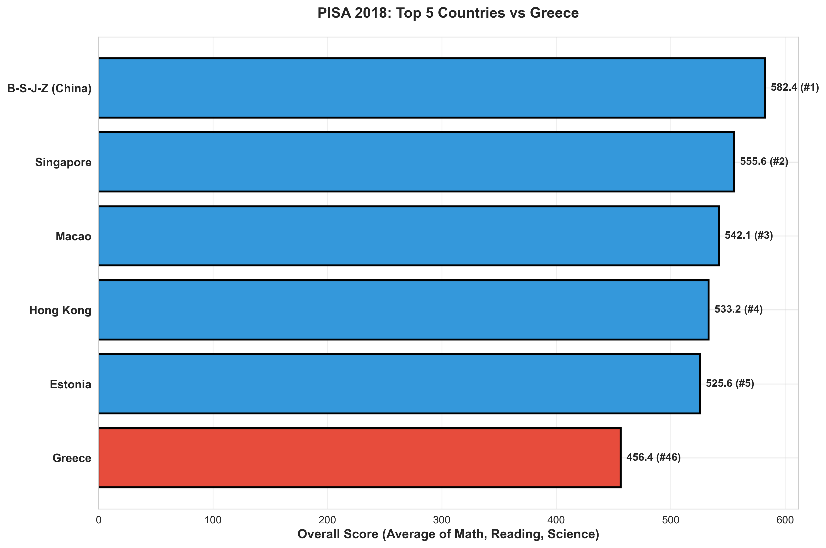
Greece's Overall Ranking
Greece ranks 46th out of 80 countries with an overall score of 456.39 points

Slide 3
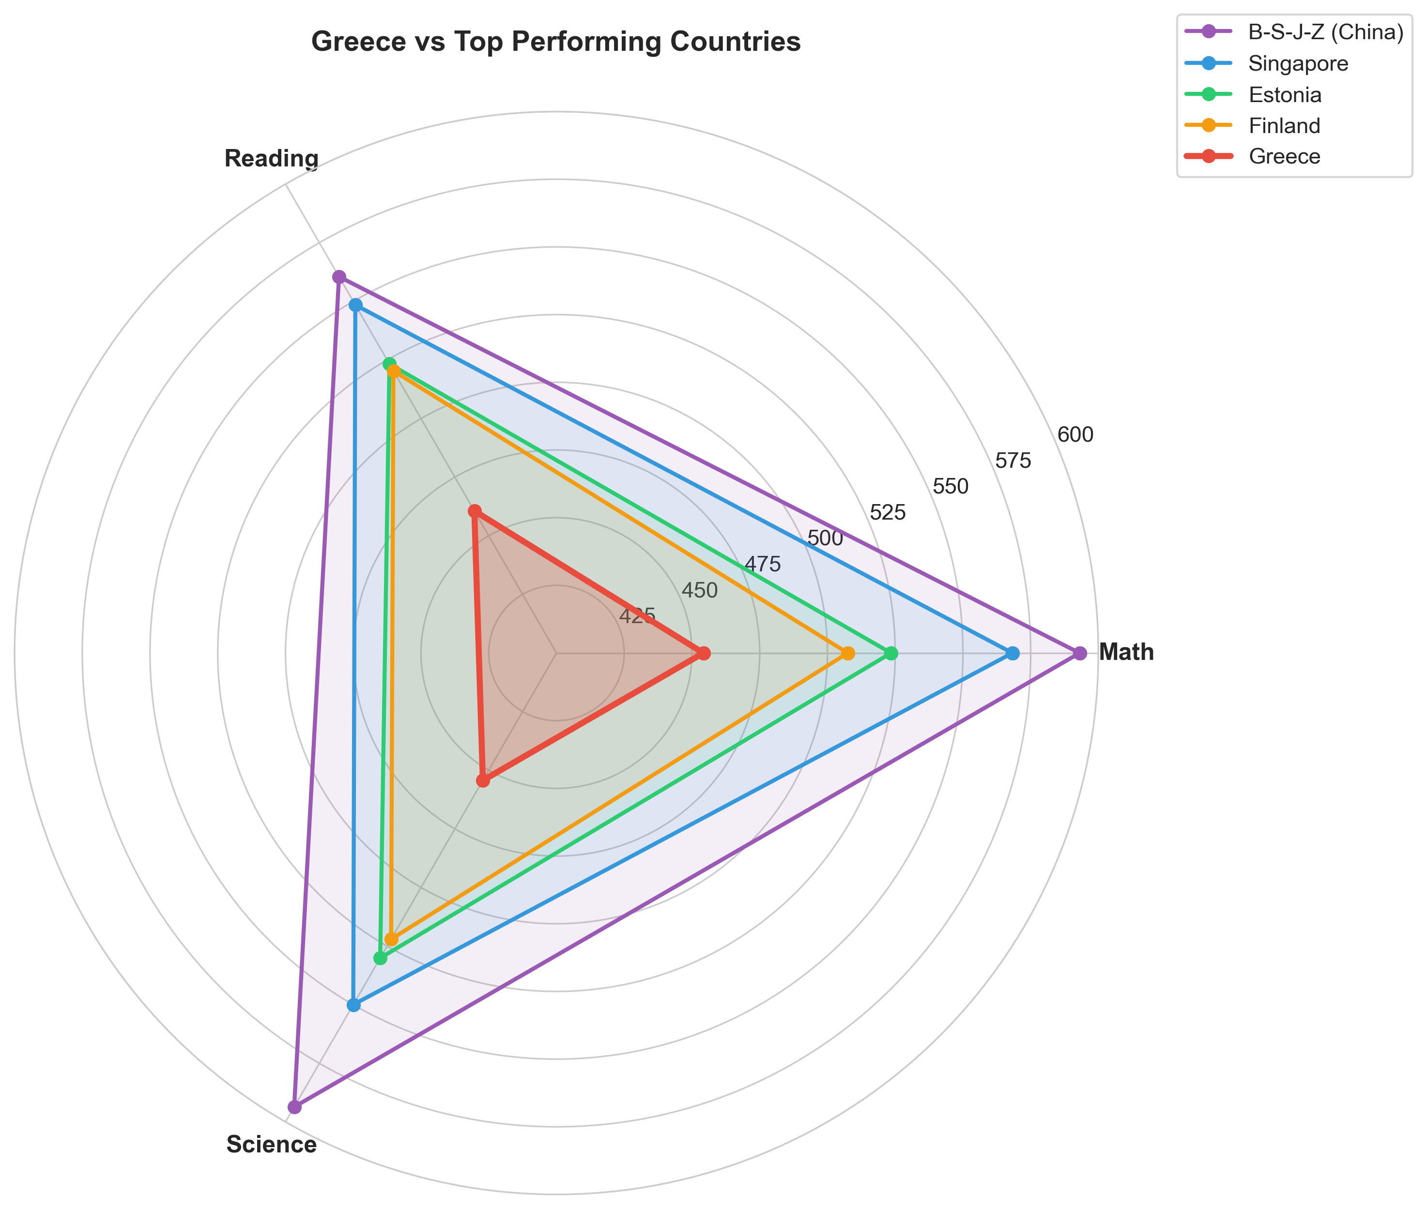
Greece vs Top Performers
Comparison with China, Singapore, Estonia, and Finland across three subjects

Slide 4
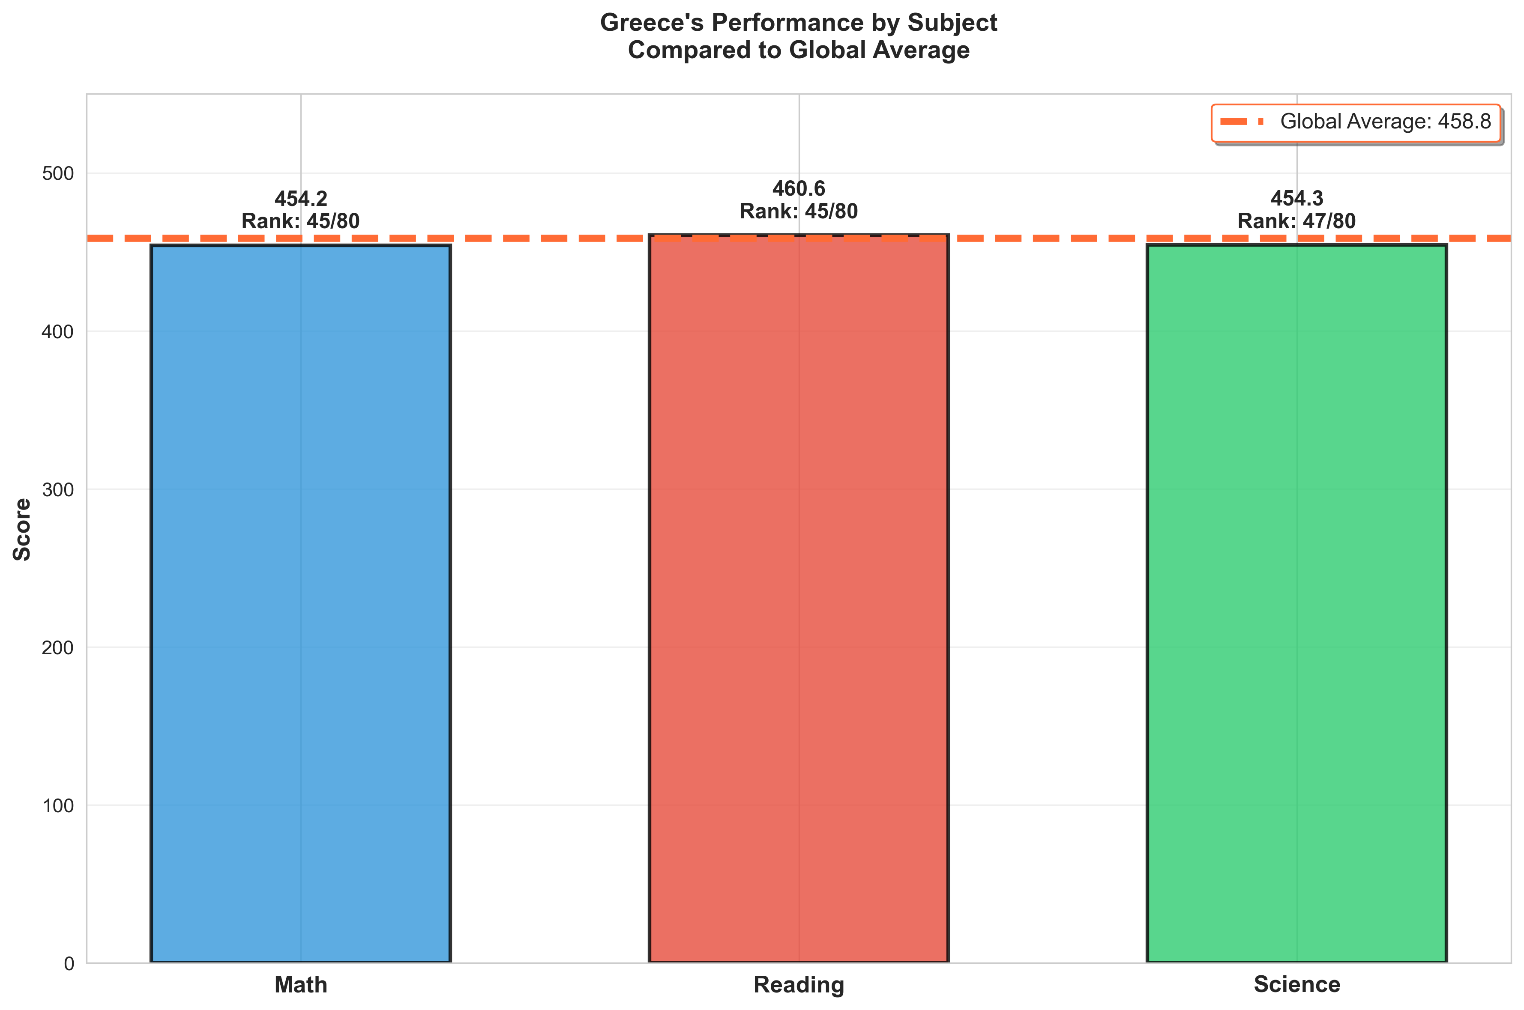
Greece's Performance by Subject
Math: 454.2 | Reading: 460.6 | Science: 454.3 - All below global average

Slide 5
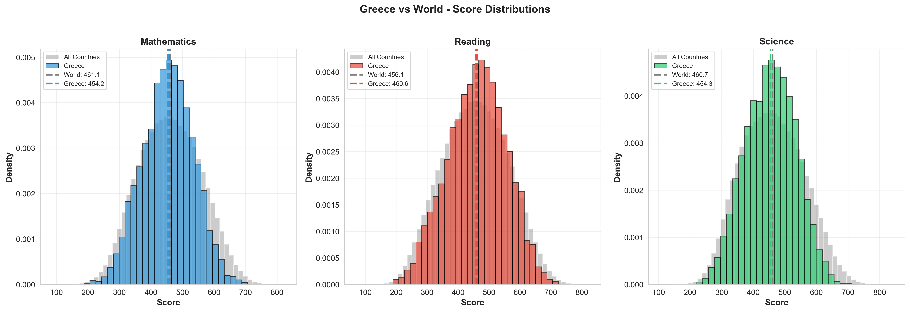
Score Distributions: Greece vs World
Distribution analysis shows Greece performs consistently below global means

Slide 6
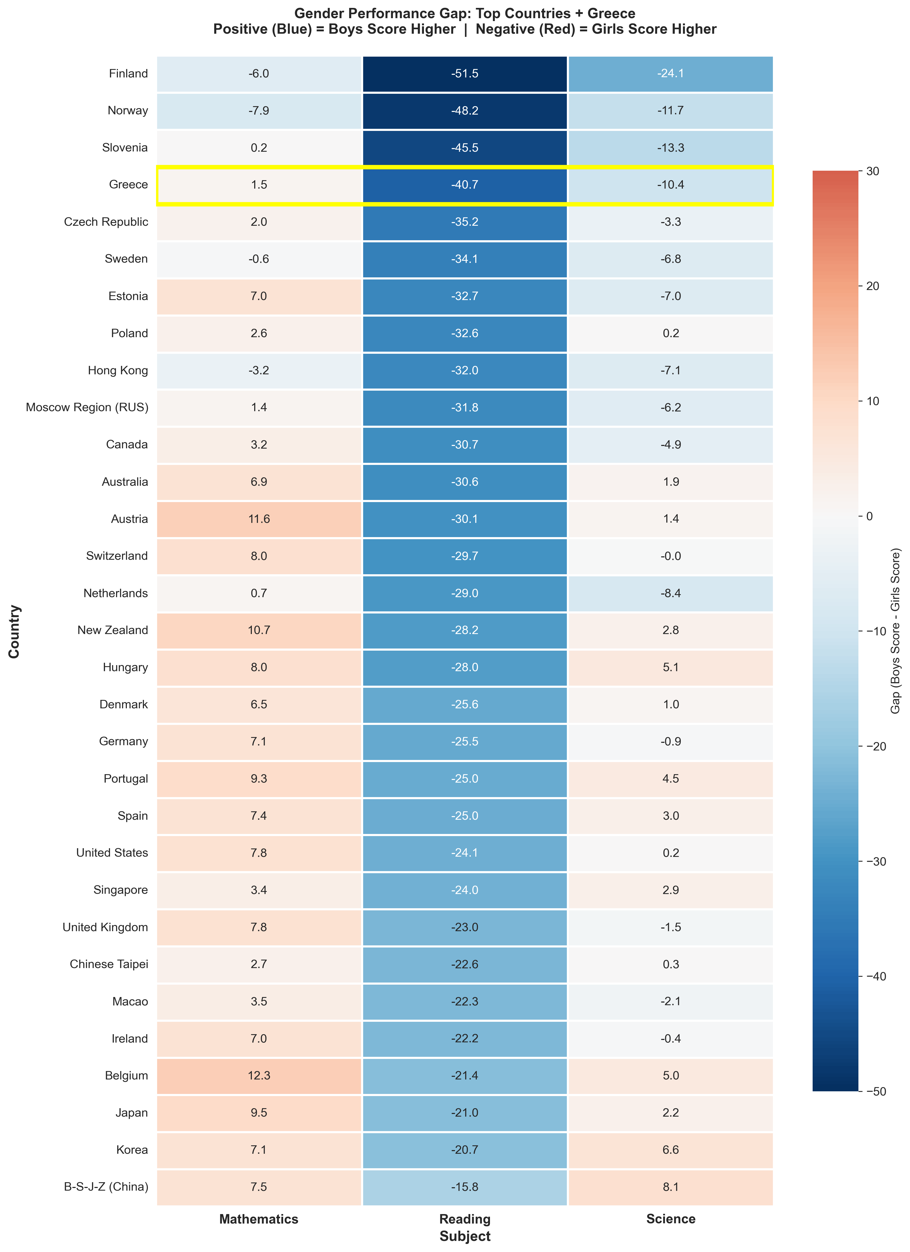
Gender Gap Heatmap
Top 30 countries + Greece. Red indicates girls score higher (Reading), Blue indicates boys score higher

Slide 7
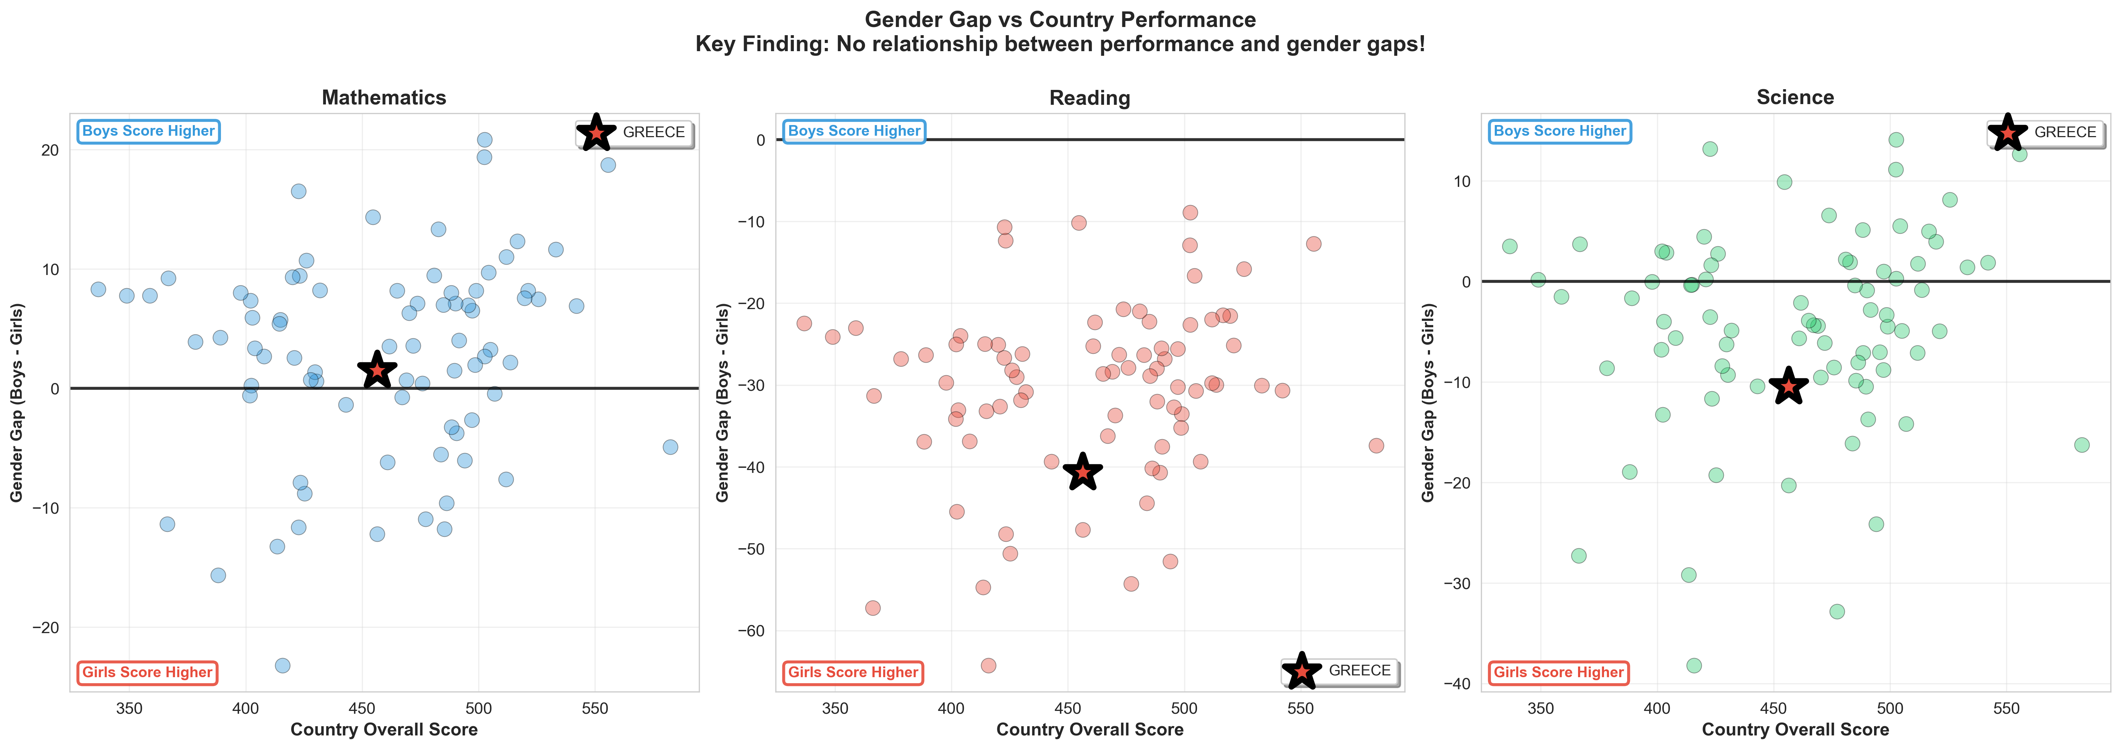
Gender Gap vs Country Performance
No correlation between overall performance and gender gaps across subjects

Slide 8
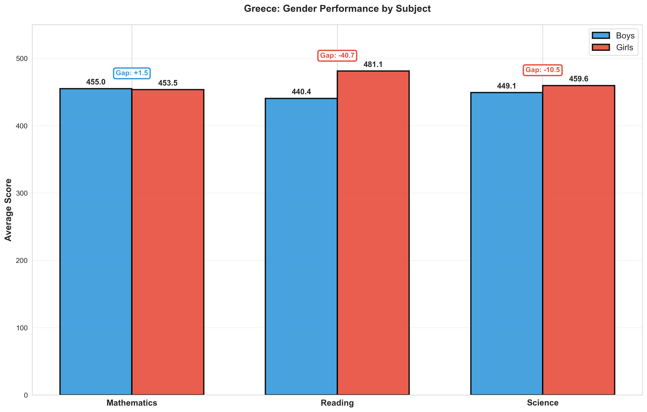
Greece's Gender Performance
Math: Nearly equal | Reading: Girls +40.7 pts | Science: Girls +10.5 pts

Slide 9
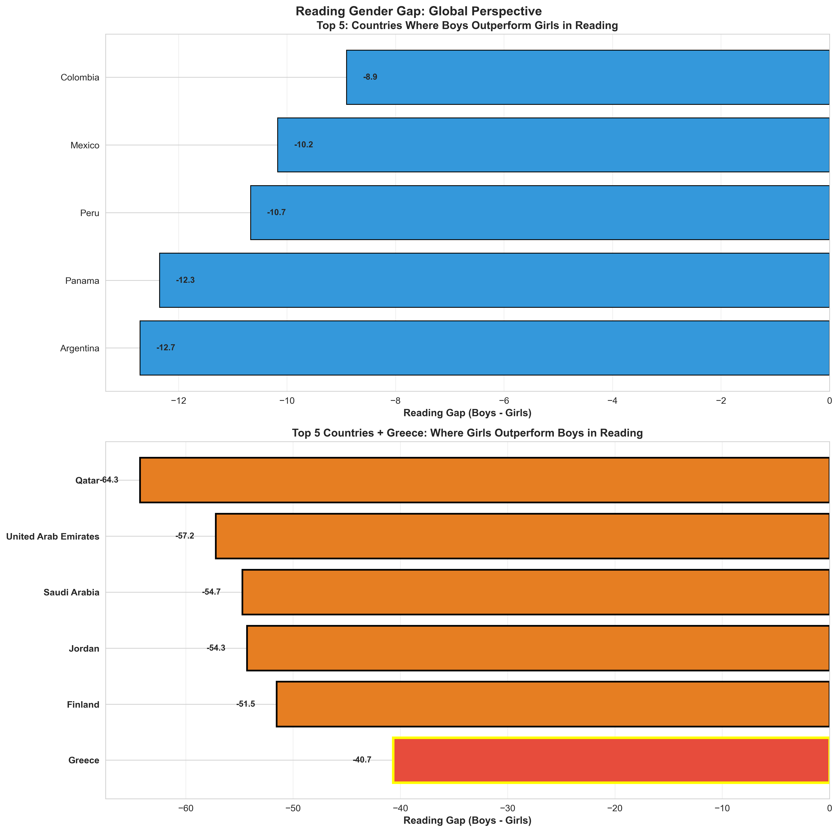
Reading Gender Gap - Global Context
Greece shows one of the largest gender gaps favoring girls in reading

Slide 10
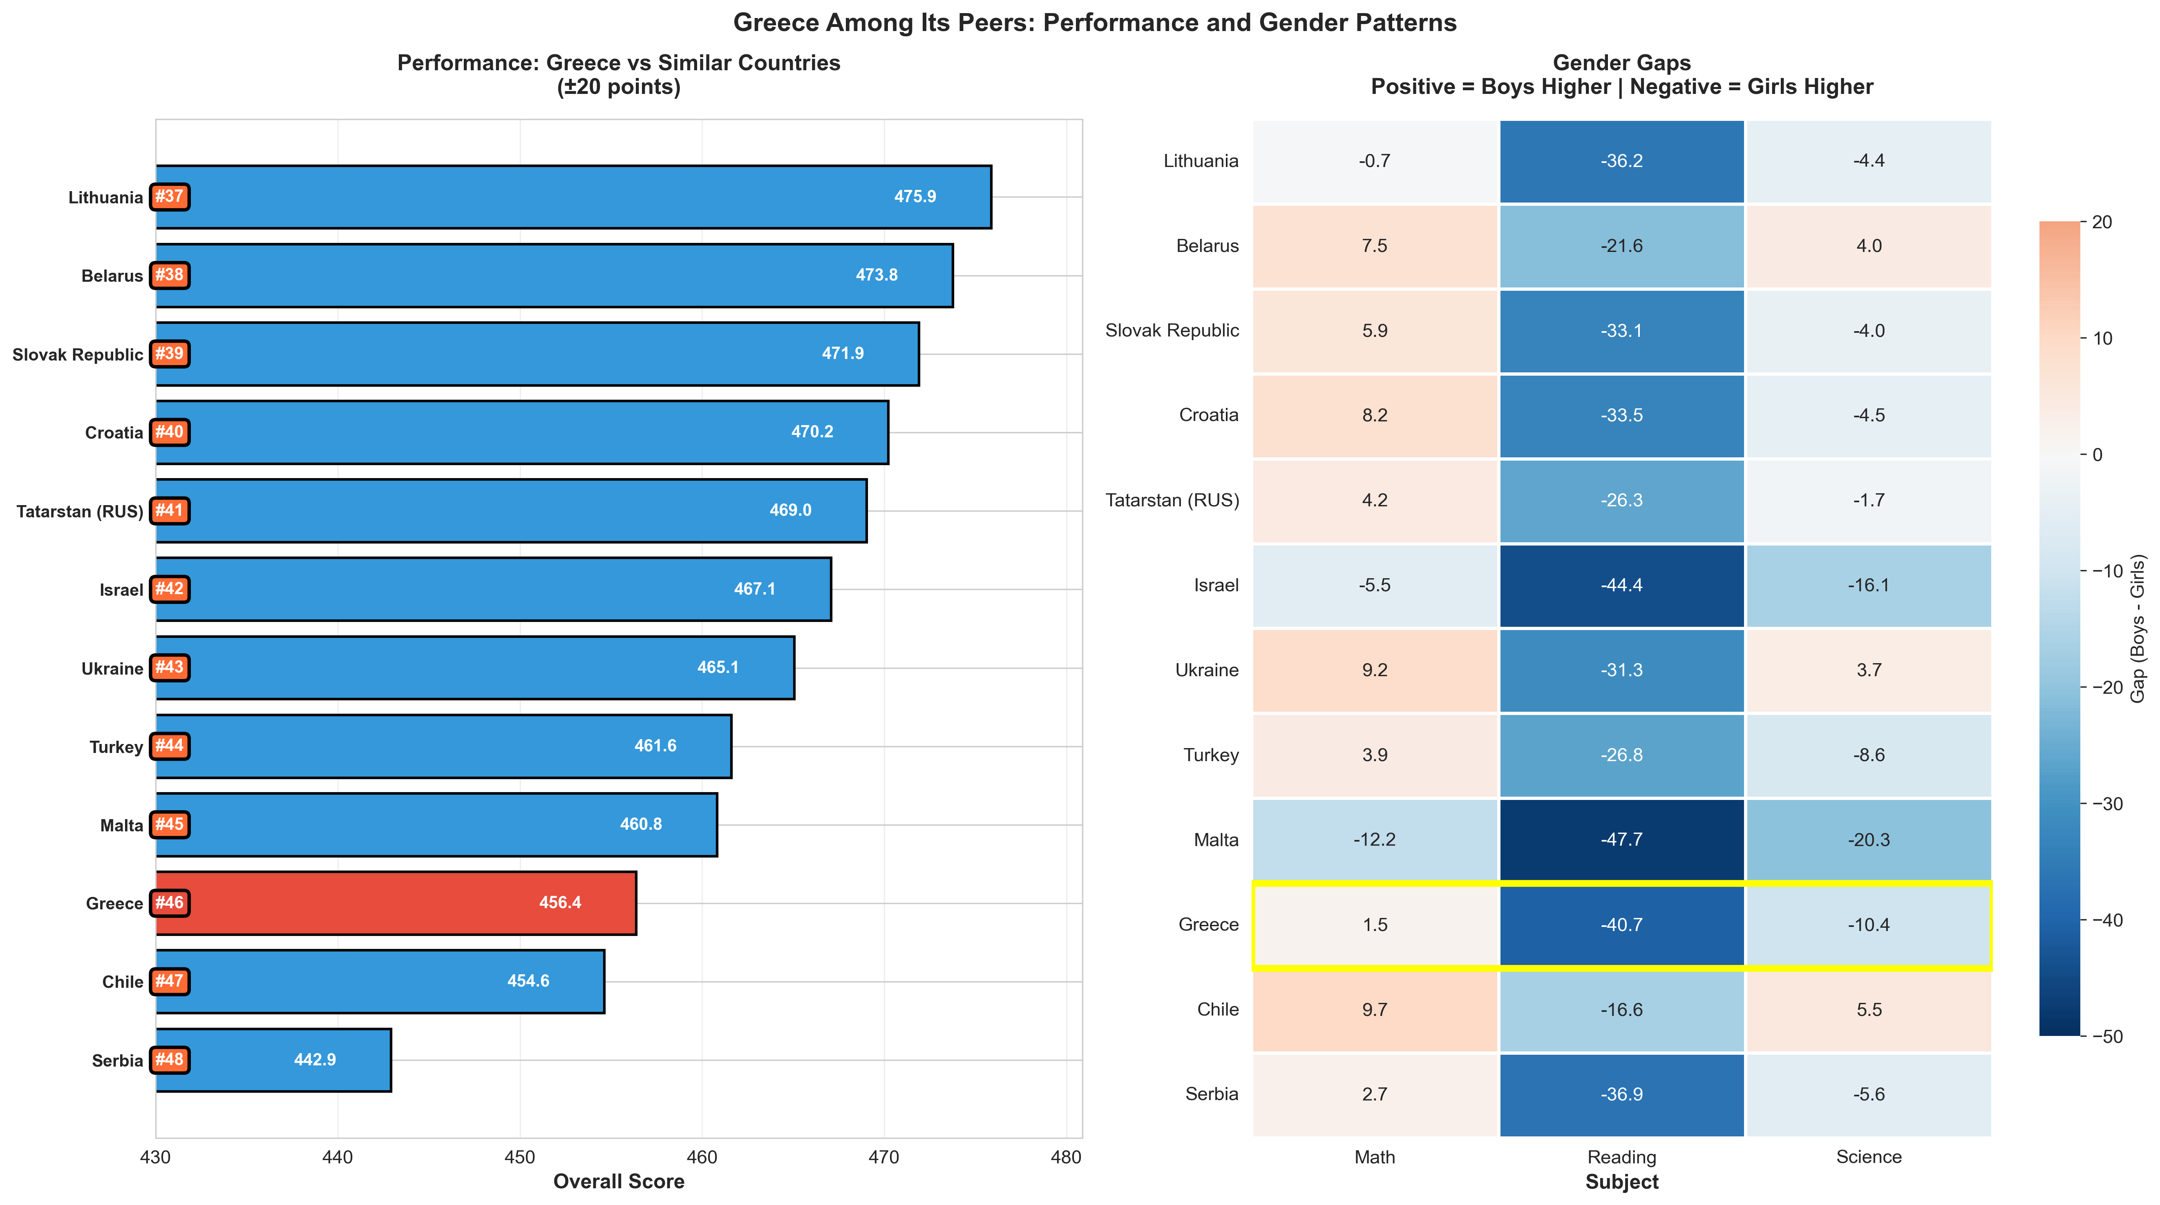
Greece Among Peer Countries
Comparison with 11 countries scoring within ±20 points of Greece

Slide 11
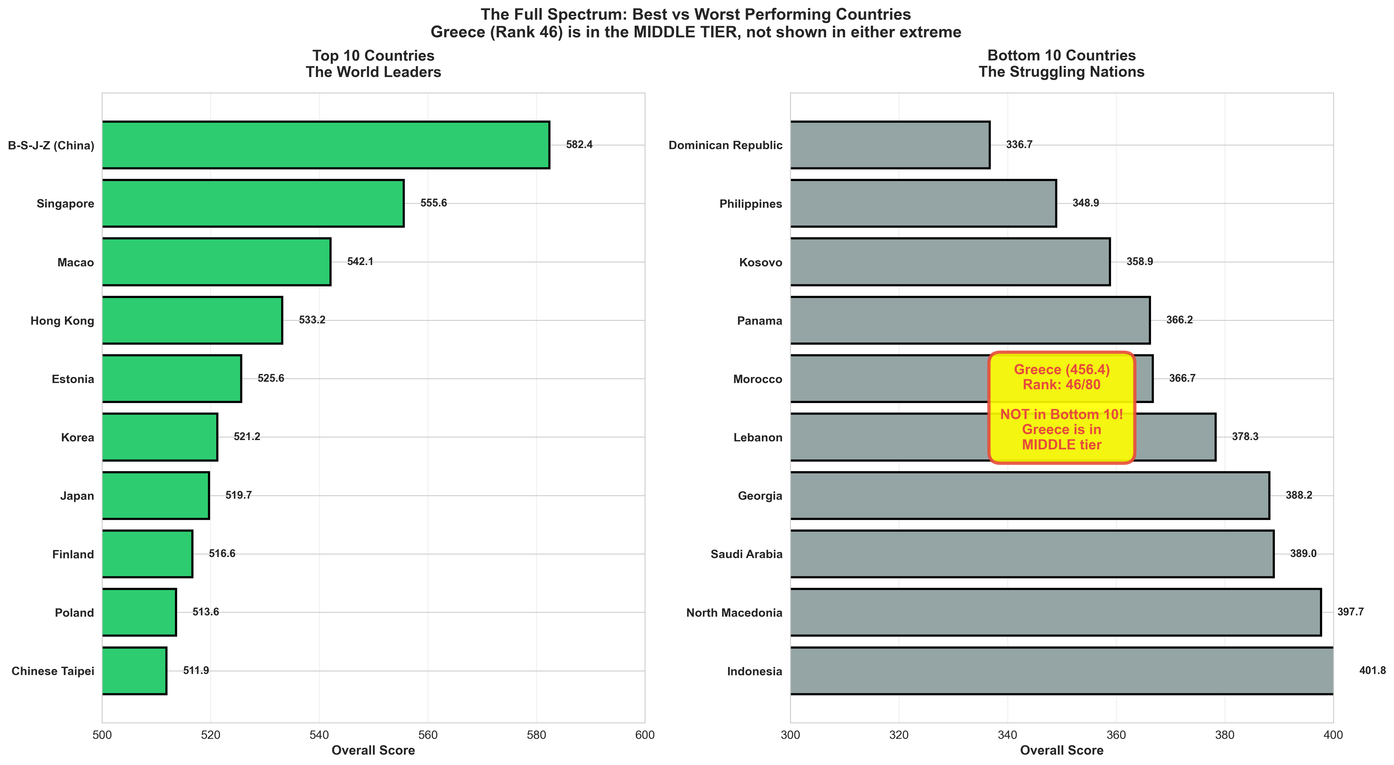
Global Performance Spectrum
Greece ranks in the middle tier - neither top 10 nor bottom 10

Slide 12
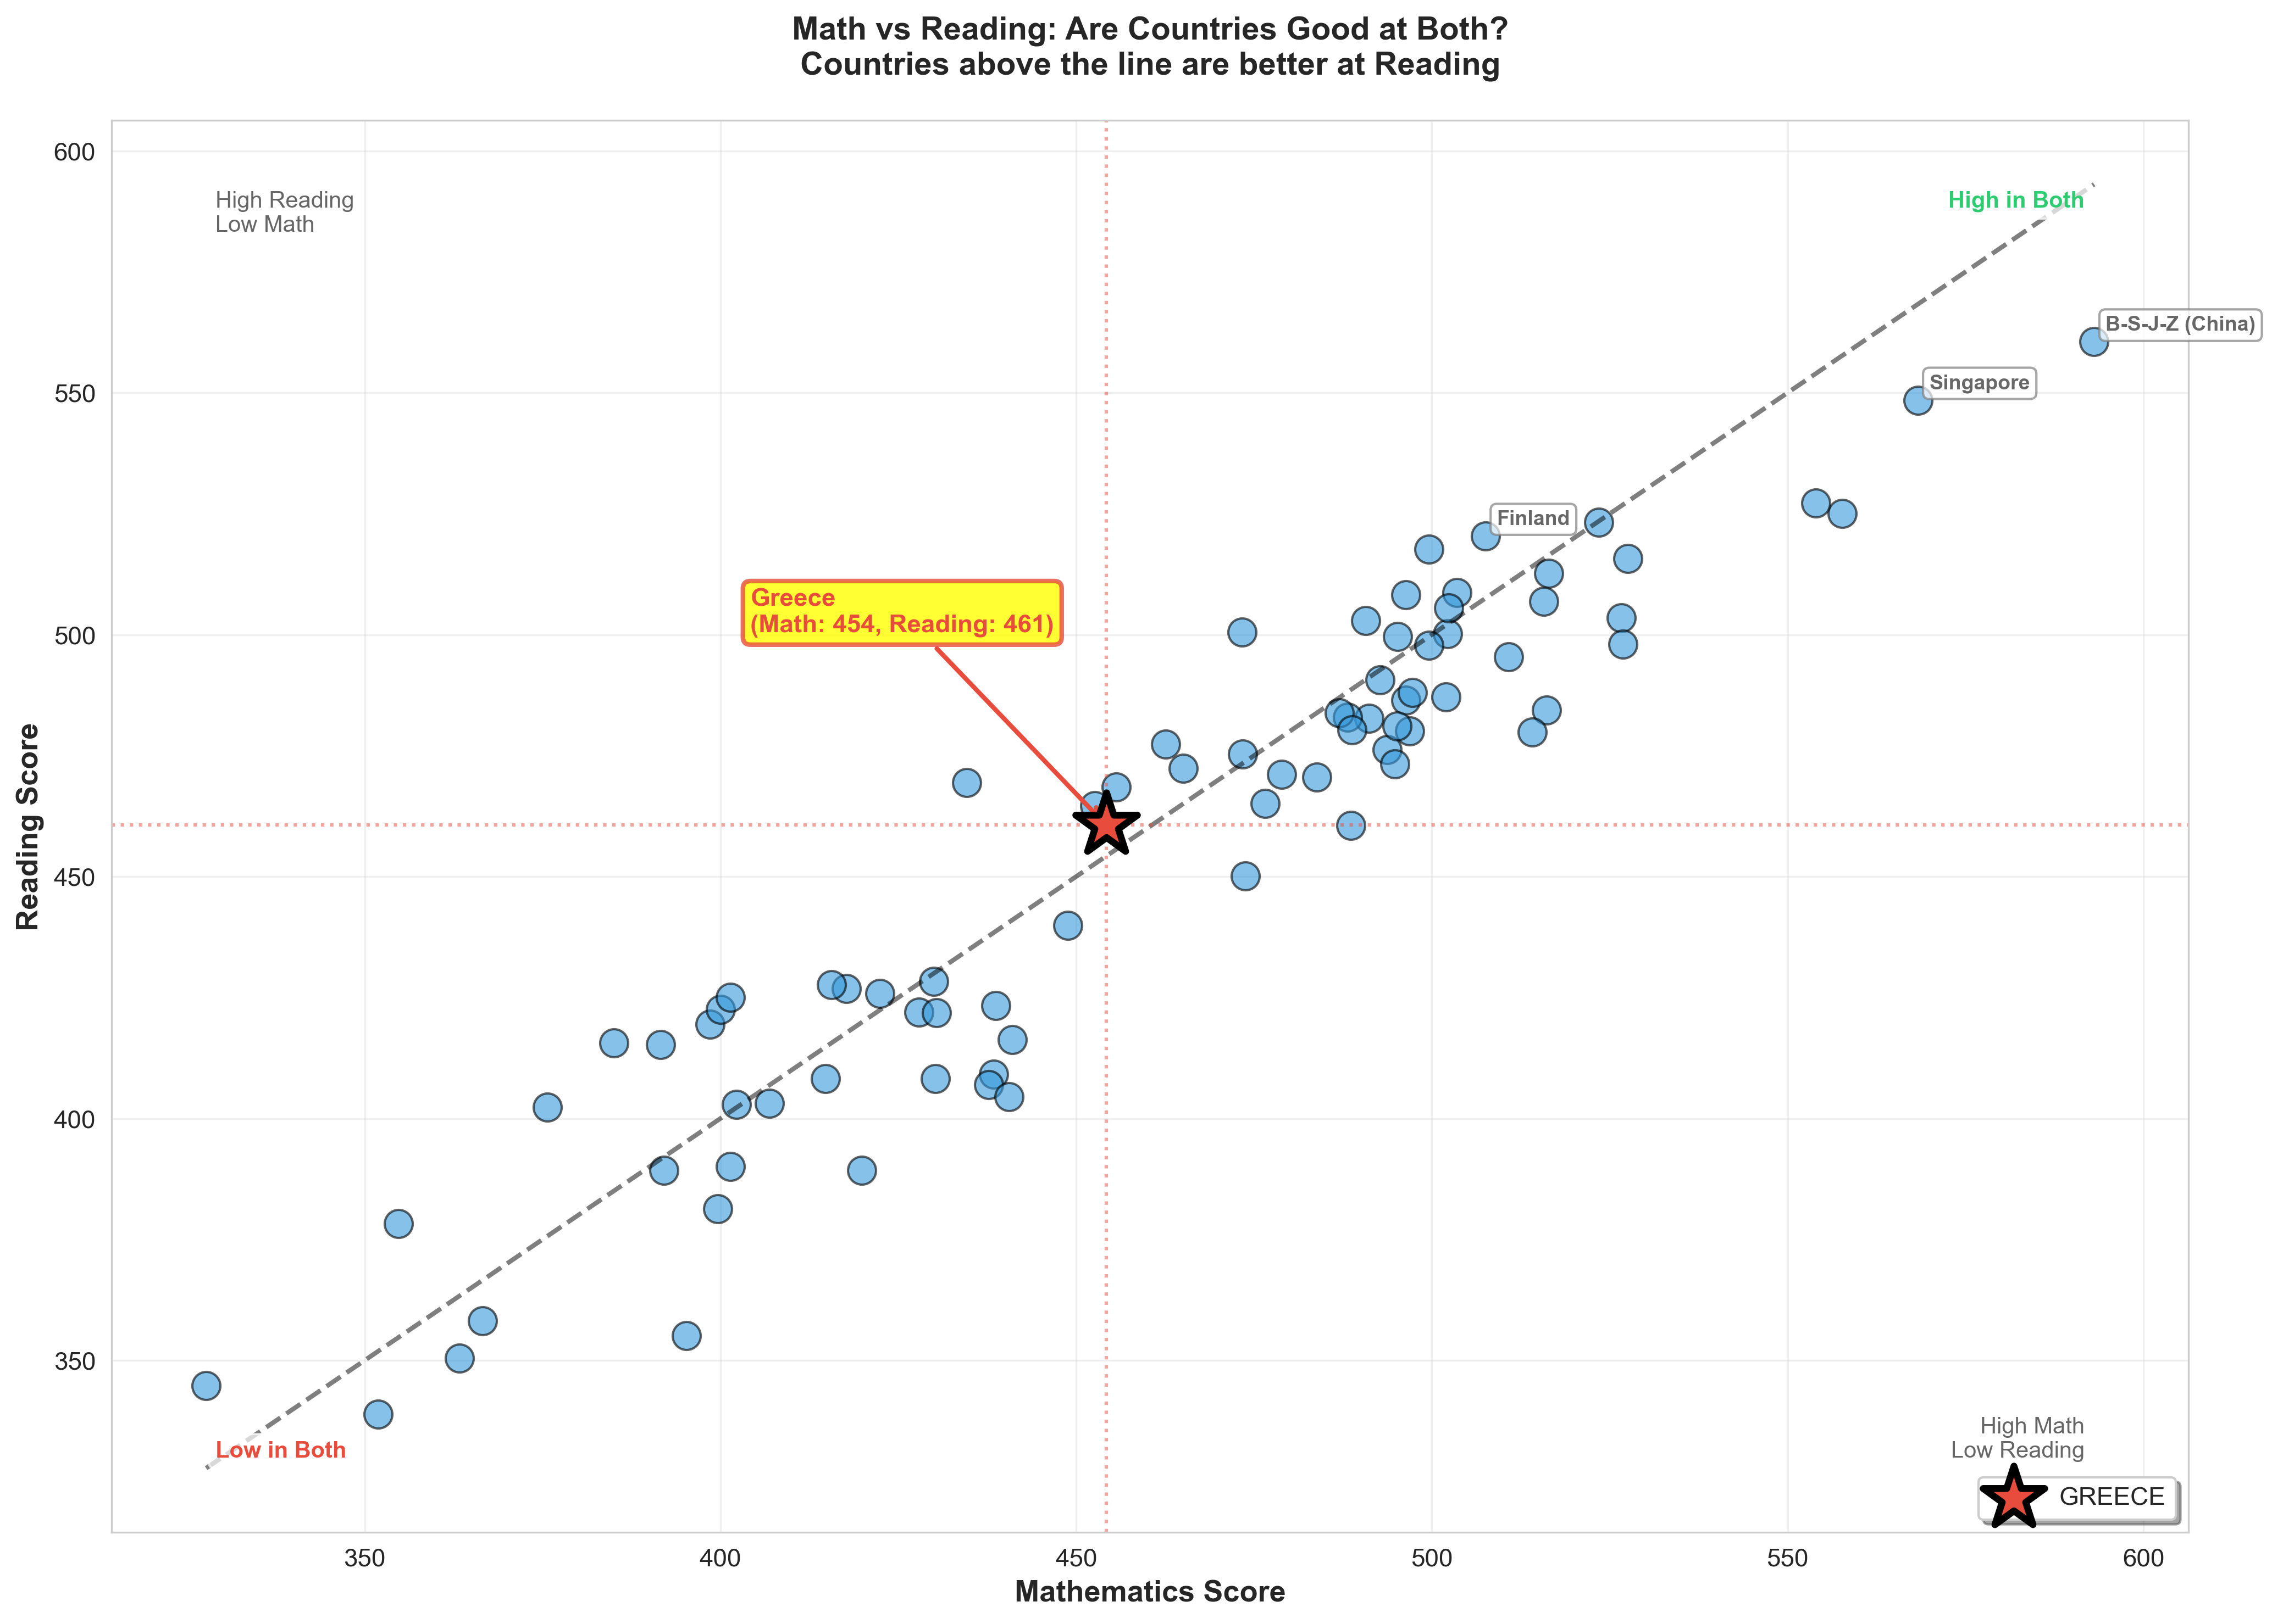
Math vs Reading Performance
Greece slightly favors reading over math compared to other countries

Slide 13
Key Findings - PISA 2018
Greece's Position (Rank 46/80):
• Overall Score: 456.39 points
• Mathematics: 454.22 (Rank 45/80)
• Reading: 460.62 (Rank 45/80)
• Science: 454.33 (Rank 47/80)
• Performance: Middle tier, below global average
Gender Gaps in Greece:
• Mathematics: Nearly equal (Boys +1.5 pts)
• Reading: Girls significantly ahead (Girls +40.7 pts)
• Science: Girls slightly ahead (Girls +10.5 pts)
Global Pattern:
• No correlation between country performance and gender gaps
• Higher-performing countries don't necessarily have smaller gaps
• Greece shows one of largest reading gaps favoring girls

